Slide 1
Building Android apps – Week 10b
2843-201710_MCS4993_M:Topics in MA/CS
2843-201710_MCS5993_M:Topics in Computer Science

Slide 2
Agenda
Material Design
https://www.raywenderlich.com/103367/material-design

Slide 3
Bullet Points
Implement the material theme;
Build dynamic views using new widgets like RecyclerView and CardView;
Use Palette API to generate color schemes that you can use for text or background views;
Create interactions using the animation APIs.

Slide 4
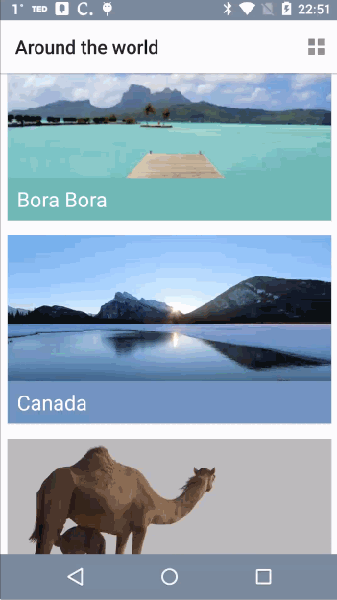
Before and After

Slide 5
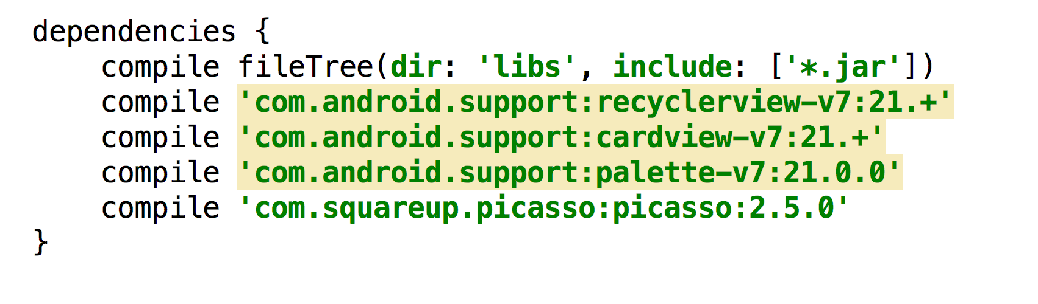
build.gradle

Slide 6
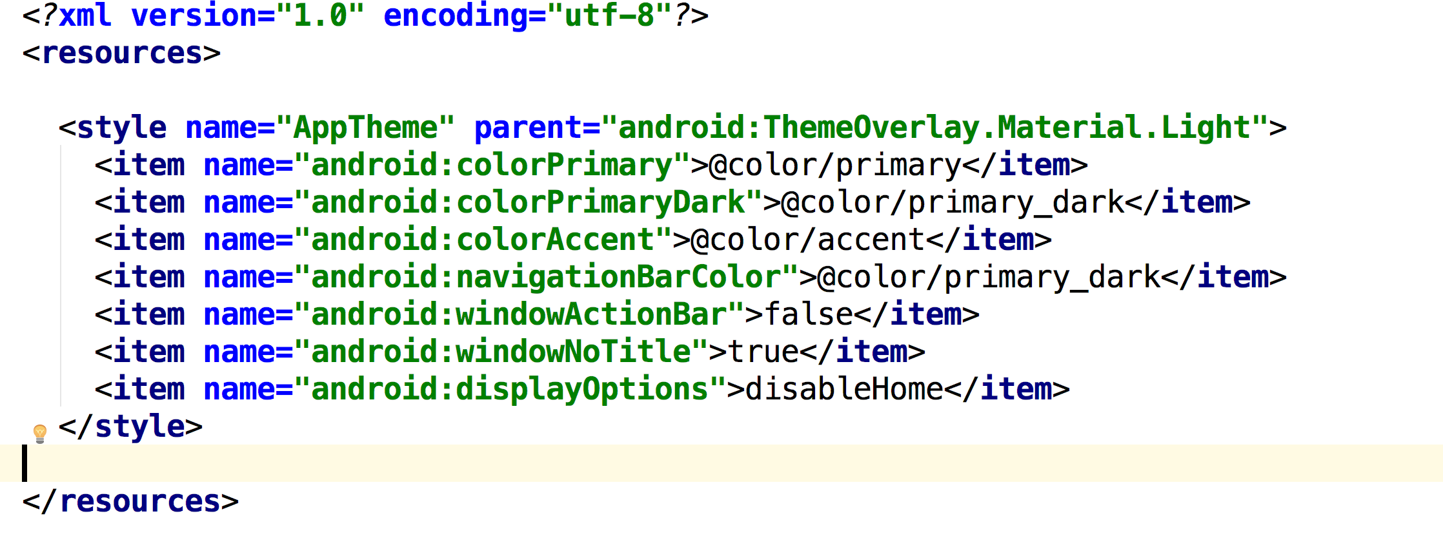
style.xml
Notes:
Setting Up the Theme
Before doing anything else, you should set up your theme. Open style.xml under the values directory.
By default, the theme selected is android:Theme.Material.Light.
Add the following items inside the theme tag:

Slide 7
style.xml
Notes:
Android will automatically apply android:colorPrimary to the action bar, android:colorPrimaryDark to status bar and android:colorAccent to UI widgets like textfield and checkboxes.
In the code above, you also alter the color of the navigation bar. For android:displayOptions, you pass disableHome to accommodate the screen layouts in this sample app.
Build and run, and you’ll see the new color scheme in the app.

Slide 8
RecyclerView
Implementing a Recycler View in XML
Initializing a Recycler View and Applying a Layout Manager
Notes:
Using the Recycler and Card Views
To give your users a window into all the cool places they might go, you need a view.
You can useRecyclerView as a replacement for ListView, but it’s much more versatile than that.
Google describes RecyclerView as “a flexible view for providing a limited window into a large data set.”
In this section, you’re going to demonstrate this by switching the view from a list to a custom grid that uses the same data source which currently supplies the ListView with the users locations.

Slide 9
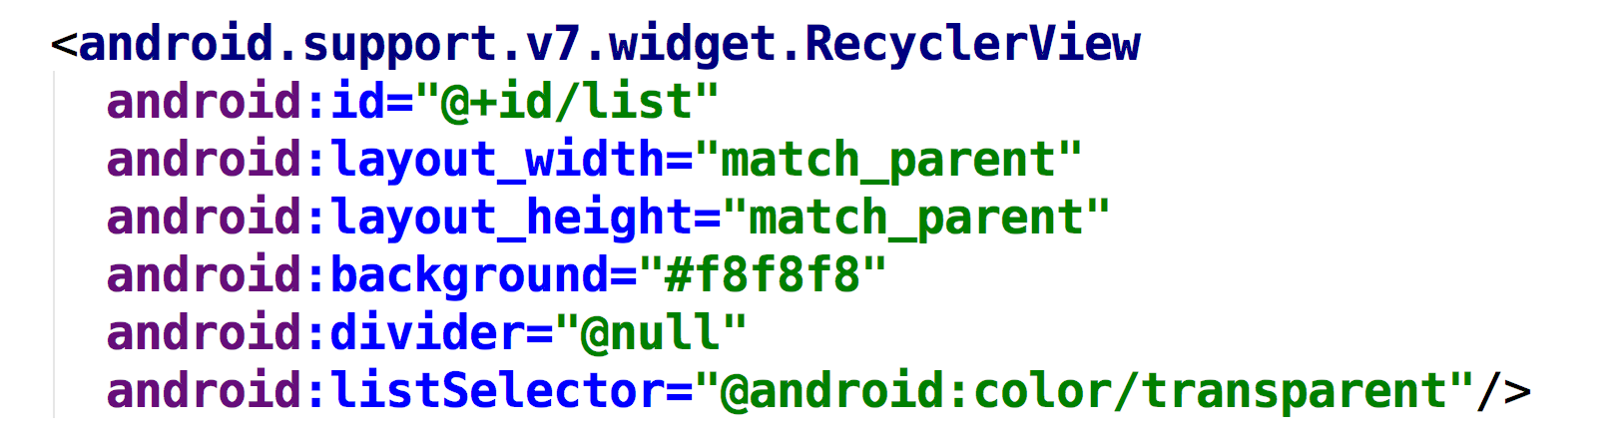
Implementing a Recycler View in XML
Notes:
First, open activity_main.xml and add the following inside the LinearLayout tag:
Here you’re adding a RecyclerView to the activity’s layout, and specifying it should match the entire size of the parent view.

Slide 10
Initializing a Recycler View
private RecyclerView mRecyclerView; private StaggeredGridLayoutManager mStaggeredLayoutManager;
Notes:
Here you’re simply declaring two fields; one to hold a reference to the RecyclerView and another to hold a reference to the LayoutManager.

Slide 11
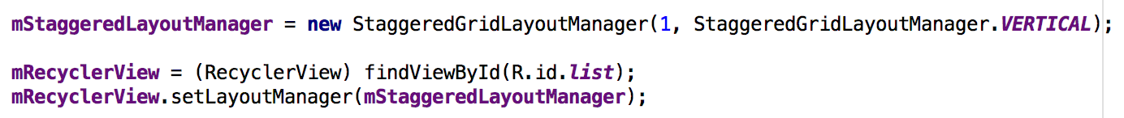
Applying a Layout Manager
Notes:
Next, add the following to the bottom of onCreate() in MainActivity.java
In the code above, you initialize RecyclerView and apply StaggeredGridLayout to it, which you’ll use to create two types of vertically staggered grids.
Here you start with the first type, passing 1 for the span count and StaggeredGridLayoutManager.VERTICAL for the orientation.
A span count of 1 makes this a list rather than a grid, as you’ll soon see.
Later, you’ll add a compact grid formation with two columns.

Slide 12
Creating Rows and Cells Using a Card View
Notes:
CardView provides a consistent backdrop for your views, including rounded corners and a drop shadow. You’re going to implement it for the row/cell layout of your RecyclerView. By default, CardView extendsFrameLayout and therefore includes the ability to host other child views.
From the res\layout directory, create a new Layout resource file and call it row_places.xml. Press OK to create it.

Slide 13
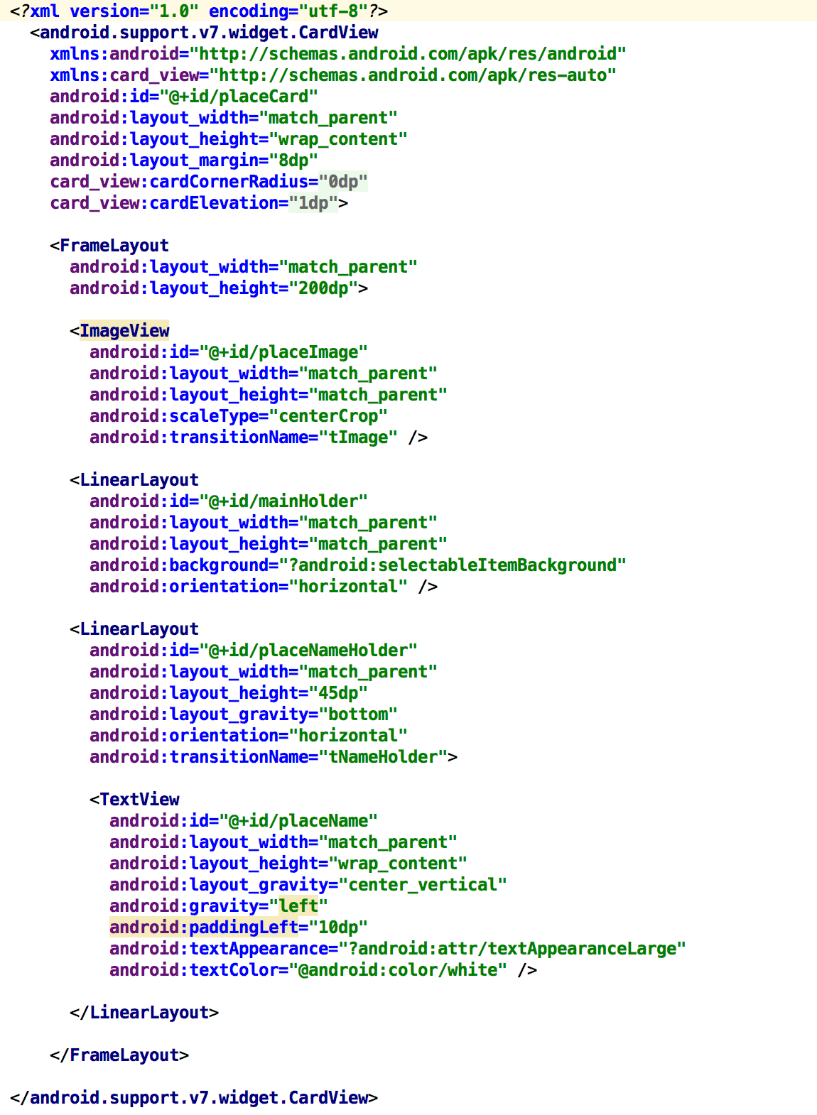
Notes:
By adding xmlns:card_view="http://schemas.android.com/apk/res-auto", you can define attributes likecard_view:cardCornerRadius and card_view:cardElevation that are responsible for giving Material Design enabled Android apps their signature card-like look.
Notice that for mainHolder, you’ve added ?android:selectableItemBackground as the background. This enables the ripple effect animation when the user touches a cell, as seen in many Android apps now.

Slide 14
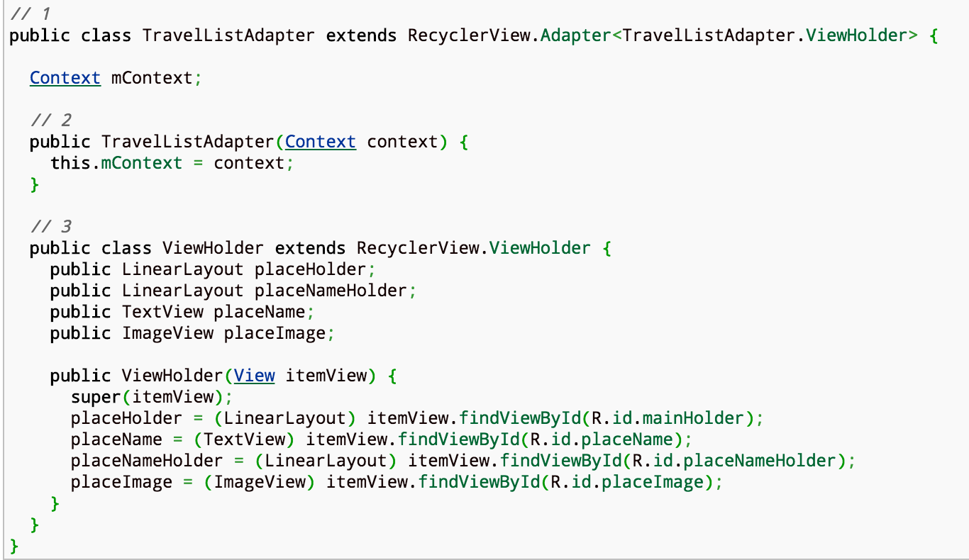
Implementing an Adapter for a Recycler View
Notes:
You’re going to use an adapter for the RecyclerView to bind data to the view. In the Java folder, right-click on the bhouse.travellist_starterproject package and select New\Java class. Call the classTravelListAdapter.

Slide 15
Notes:
A couple of things are happening above:
1. make TravelListAdapter extend Recycler.Adapter so that you can implement logic for the override methods you’ll add soon.
2. add a constructor where the context can be passed when you create an instance ofTravelListAdapter in MainActivity, which you’ll do a bit later in the tutorial.
3. create the ViewHolder class. Whereas the use of the ViewHolder pattern is optional in ListView,RecyclerView enforces it.
This improves scrolling and performance by avoiding findViewById() for each cell.

Slide 16
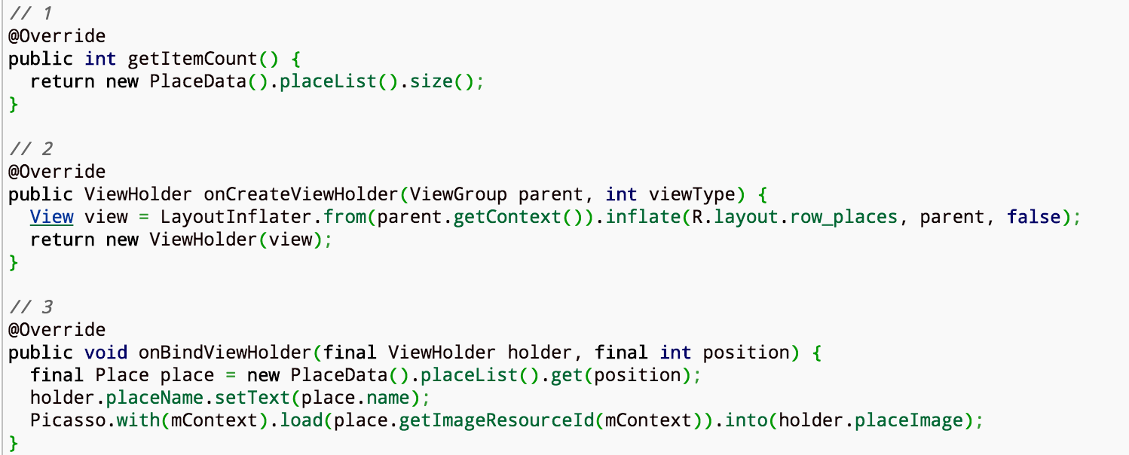
TravelListAdapter.java
Notes:
Here’s what’s happening:
getItemCount() returns the number of items from your data array. In this case, you’re using the size of the PlaceData.placeList().
onCreateViewHolder(...) returns a new instance of your ViewHolder by passing an inflated view of row_places.
onBindViewHolder(...) binds the Place object to the UI elements in ViewHolder. You’ll use Picasso to cache the images for the list.

Slide 17
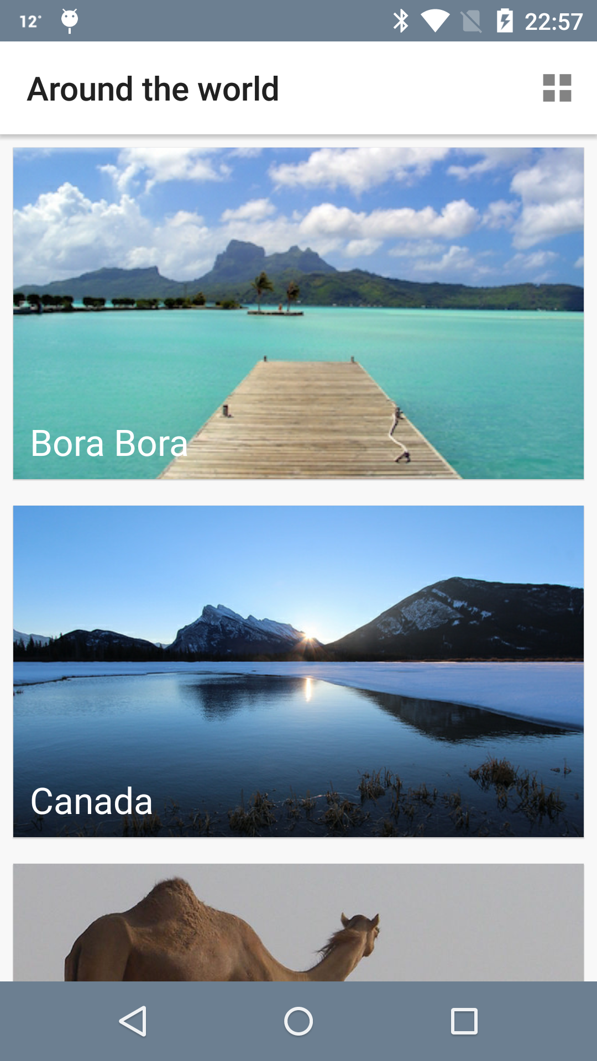
MainActivity.java
Private TravelListAdapter mAdapter;
mAdapter = new TravelListAdapter(this); mRecyclerView.setAdapter(mAdapter);
Notes:
Add a field in MainActivity that will hold a reference to your adapter:
And then create an instance of your adapter and pass it to the RecyclerView at the bottom of onCreate(), just after you configure the layout manager:

Slide 18
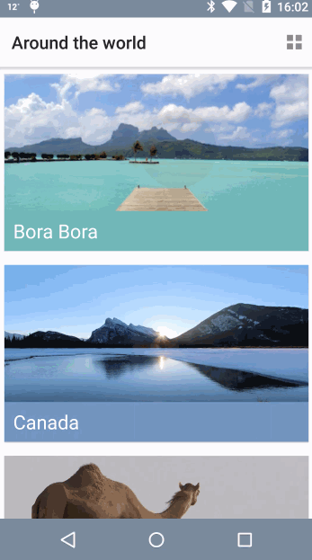
Implementing a Click Interface for Each Cell
Notes:
Unlike ListView, RecyclerView doesn’t come with an onItemClick interface, so you have to implement one in the adapter.
Notice the new ripple effect every time you touch a row:

Slide 19
Implementing a Click Interface for Each Cell
OnItemClickListener mItemClickListener;
public class ViewHolder extends RecyclerView.ViewHolder implements View.OnClickListener {
@Override public void onClick(View v) {
}
placeHolder.setOnClickListener(this);
Notes:
In TravelListAdapter, create a field to hold an instance of OnItemClickListener. Add the following just below the existing fields
Now implement View.OnClickListener by adding the interface to the ViewHolder inner class definition:
Then add the onClick() method stub to the inner ViewHolder class:
Finally, hook the two up by adding placeHolder.setOnClickListener to the bottom of ViewHolder():

Slide 20
public interface OnItemClickListener { void onItemClick(View view, int position); }
public void setOnItemClickListener(final OnItemClickListener mItemClickListener) {
this.mItemClickListener = mItemClickListener;
}
@Override public void onClick(View v) { if (mItemClickListener != null) { mItemClickListener.onItemClick(itemView, getPosition()); } }
Notes:
You need to do a few more things to implement the onClick interface for the RecyclerView.
First, after the inner ViewHolder class definition add the OnItemClickListener:
Next, add the setter method of the onClickListener:
Now implement the logic in the empty onClick() stub within the inner ViewHolder class:

Slide 21
TravelListAdapter.OnItemClickListener onItemClickListener = new TravelListAdapter.OnItemClickListener() {
@Override
public void onItemClick(View v, int position) {
Toast.makeText(MainActivity.this, "Clicked " + position, Toast.LENGTH_SHORT).show();
}
};
mAdapter.setOnItemClickListener(onItemClickListener);
Notes:
In MainActivity, create an instance of OnItemClickListener below onCreate():
set the listener to the adapter by adding the following code to the bottom of onCreate(), just after where you set the adapter:

Slide 22
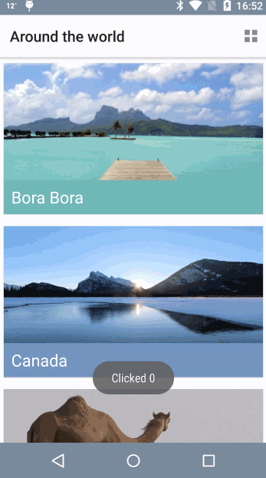
Toast notifications
Notes:
Build and run once more. Now when you tap a cell you’ll see a Toast notification displaying the position of the cell in the list.

Slide 23
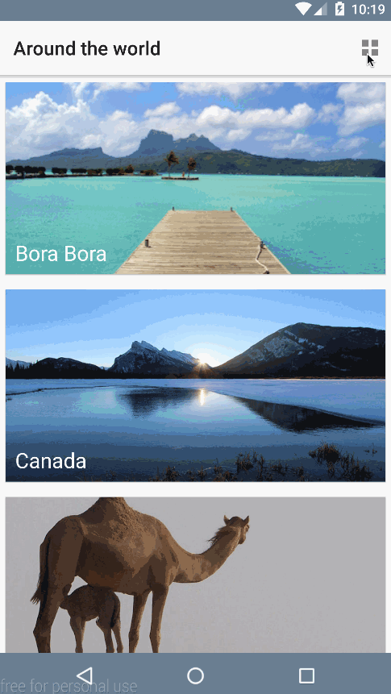
From List to Grid
Notes:
StaggeredLayoutManager lets you add versatility to your layouts. To change your existing list to a more compact two-column grid, you simply have to change the spanCount of the mLayoutManager inMainActivity.

Slide 24
From List to Grid
mStaggeredLayoutManager.setSpanCount(2);
mStaggeredLayoutManager.setSpanCount(1);
Notes:
In toggle(), add the following to the top of the if:
mStaggeredLayoutManager.setSpanCount(2);
And now add the following to the top of the else branch:
mStaggeredLayoutManager.setSpanCount(1);
Here you’re simply switching between single and double span counts, which displays single and double columns respectively.

Slide 25
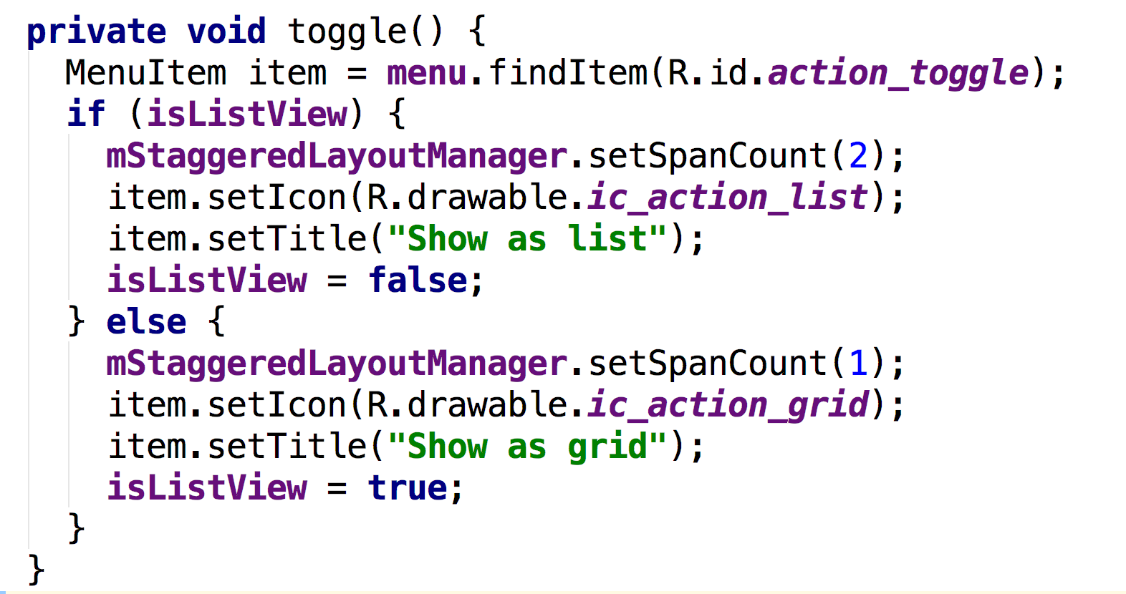
From List to Grid
Notes:
In toggle(), add the following to the top of the if:
mStaggeredLayoutManager.setSpanCount(2);
And now add the following to the top of the else branch:
mStaggeredLayoutManager.setSpanCount(1);
Here you’re simply switching between single and double span counts, which displays single and double columns respectively.

Slide 26
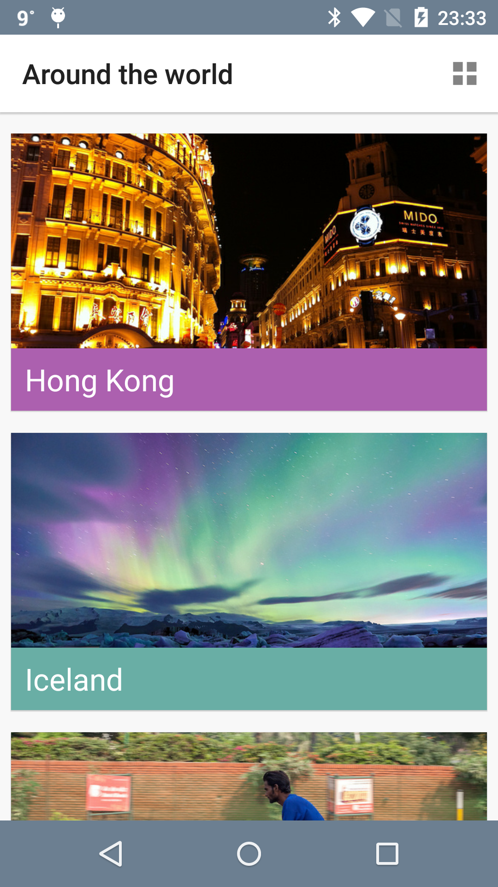
Using the Palette API in the list
Notes:
Now you can add some interesting Material Design features into the mix, starting with the Palette API.
Head back to TravelListAdapter, where you’ll define a background color for placeNameHolder that will be determined dynamically using the colors in the image.

Slide 27
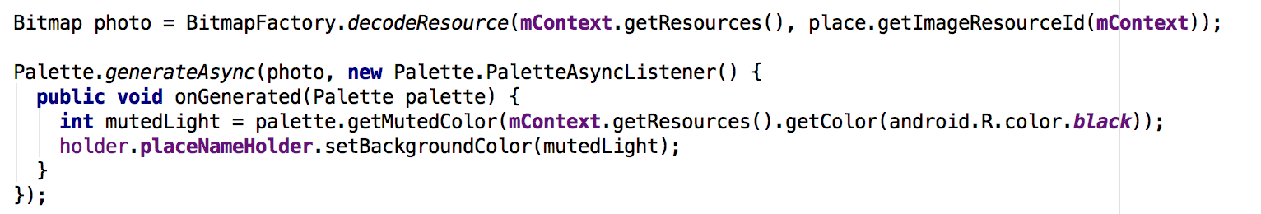
Using the Palette API in the list
Notes:
Add the following to the bottom of onBindViewHolder(...):
By using generateAsync(...) to generate a color palette in the background, you’ll receive a callback when the palette has been generated in the form of onGenerated(...). Here you can access the generated color palette and set the background color of holder.placeNameHolder. If the color doesn’t exist, the method will apply a fallback color — in this case, android.R.color.black.

Slide 28
Palette API Color Profiles
Vibrant
Vibrant Dark
Vibrant Light
Muted
Muted Dark
Muted Light
Notes:
The Palette API can extracts the following color profiles from an image:

Slide 29
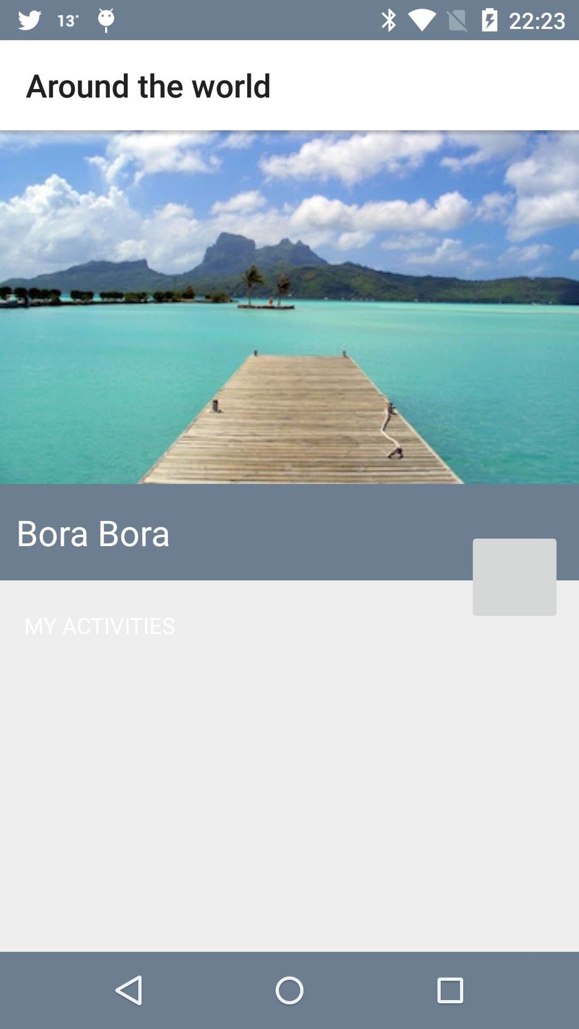
Material APIs
Intent intent = new Intent(MainActivity.this, DetailActivity.class);
intent.putExtra(DetailActivity.EXTRA_PARAM_ID, position);
startActivity(intent);
Notes:
In this section, you’ll use DetailActivity and its corresponding activity_detail layout, and make them cooler by infusing some of the new Material Design APIs.
First, you’ll want to see how the detail view currently looks in the starter project. To see this, go toMainActivity and create an intent in onItemClickListener. Add the following to the bottom ofonItemClick(...):
You pass the position of the place object via the intent so that DetailActivity can retrieve the information and use it to layout the interface. That’s what you’re doing here.
Build and run.
There isn’t anything crazy going on here, but you’ve a floating action button.

Slide 30
Adding a Floating Action Button with Ripple
<?xml version="1.0" encoding="utf-8"?> <ripple xmlns:android="http://schemas.android.com/apk/res/android" android:color="?android:colorControlHighlight"> </ripple>
Notes:
The floating action button (FAB) pattern is common to most Android apps, such as Gmail, Calendar and Drive. It is essentially the main call to action on the screen. Create a new drawable resource file under res\drawable. Call the file btn_background.xml and define ripple as the root element, like below:

Slide 31
Adding a Floating Action Button with Ripple
<?xml version="1.0" encoding="utf-8"?> <ripple xmlns:android="http://schemas.android.com/apk/res/android" android:color="?android:colorControlHighlight"> <item> <shape android:shape="oval"> <solid android:color="?android:colorAccent" /> </shape> </item> </ripple>
Notes:
Select Insert required attribute android:color. Also pass in the default touch feedback color and the shape of the button. The completed ripple tag should look like the following:
This provides an oval-shaped background with the animation effect for the button.

Slide 32
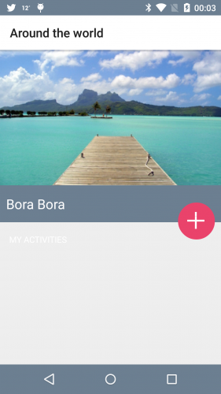
Adding a Floating Action Button with Ripple
<ImageButton android:id="@+id/btn_add" android:layout_width="@dimen/floating_button_size" android:layout_height="@dimen/floating_button_size" android:layout_gravity="end" android:layout_marginEnd="10dp" android:layout_marginTop="28dp" android:alpha="0.0" android:background="@drawable/btn_background" android:contentDescription="@null" android:elevation="@dimen/button_elevation"/>
Notes:
In activity_detail.xml, add the following inside the ImageButton tag:
android:background="@drawable/btn_background"
Here you’re instructing Android to use your new drawable as the background for the button.
Build and run. You’ll see a more prominent FAB that responds to touch with the ripple effect described above.

Slide 33

Adding a Reveal Animation
Notes:
Now you want to give your users the ability to add notes about what they’d like to do in each of these places. For this, activity_detail.xml already has an edittext that is hidden by default.
When a user taps the FAB, it reveals itself with a cool animation like below:

Slide 34
Adding a Reveal Animation
revealEditText()
hideEditText()
Notes:
Open DetailActivity. There are two methods you have yet to implement:

Slide 35
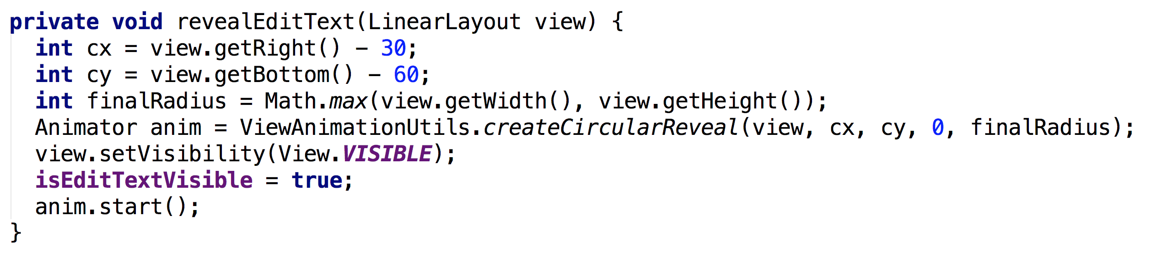
Notes:
The two int values are getting the x and y positions of the view with a slight offset.
This offset gives the illusion that the reveal is happening from the direction of your FAB.
Next, the radius gives the reveal the circular outline that you can see in the GIF above.
All of these values — the x-position, y-position and the radius — you pass into the animation instance.
This animation is usingViewAnimationUtils, which gives you the ability to create this circular reveal.
Since the EditText view is initially hidden, you set the view’s visibility to VISIBLE and set your boolean check isEditTextVisible to true.
Finally, you can call start() on the animation.

Slide 36
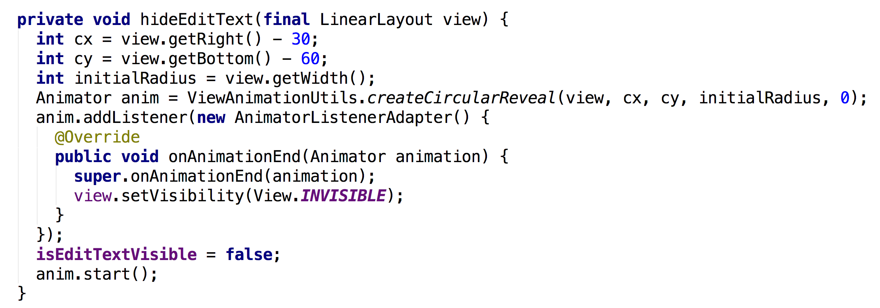
Notes:
To dismiss the view, add the following to hideEditText():
Here your goal is to hide the view and show the circular animation in the opposite direction.
Therefore, you make the initial radius the width of the view and the ending radius 0, which shrinks the circle.
You want to show the animation first and then hide the view.
To do this, you implement an animation listener and hide the view when the animation ends.

Slide 37
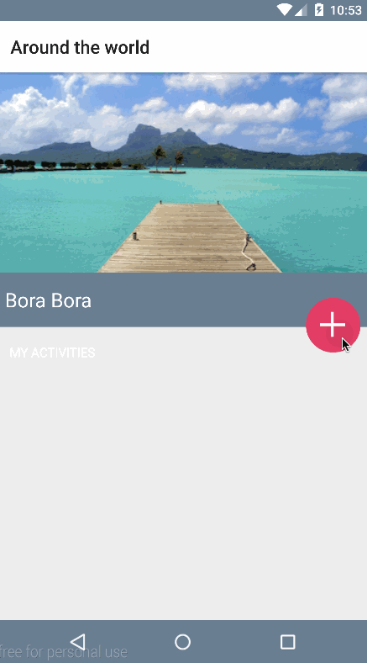

Slide 38
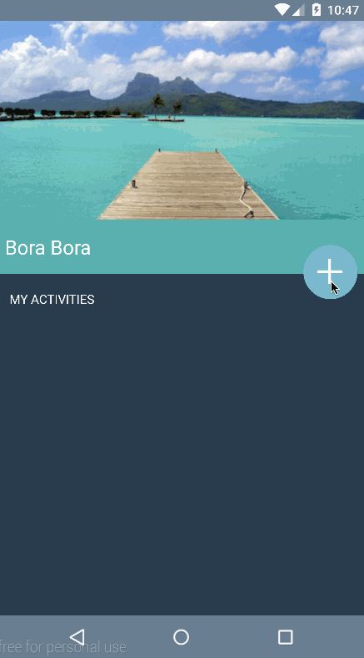
Morphing FAB
Notes:
Morphing a Bezier Path for a Floating Action Button
Now that you have your reveal animation hiding and showing the edit text field,
you can coordinate the icon on your FAB to look and respond just like the one shown below:

Slide 39
Morph FAB
<?xml version="1.0" encoding="utf-8"?> <animated-vector xmlns:android="http://schemas.android.com/apk/res/android" android:drawable="@drawable/icn_add">
</animated-vector>
Notes:
The starter project includes the vector paths for the plus and checkmark icons.
You’ll learn how to animate – or morph – the paths from the plus to the checkmark, and vice versa.
Under the drawables directory, create a new resource file by going to New\Drawable resource file.
Call iticn_morph and define animated-vector as the root element:

Slide 40
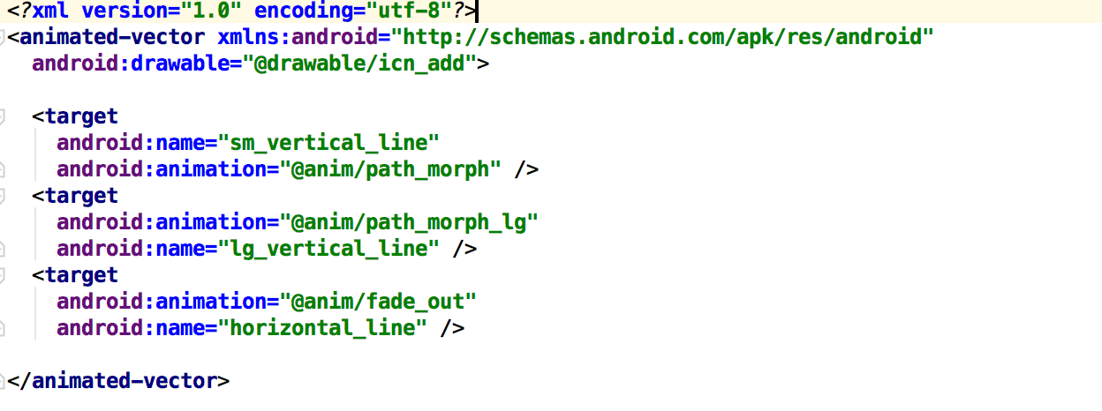
Morph FAB
Notes:
animated-vector requires an existing android:drawable.
In this case, the animated vector will start with a plus sign and morph into a checkmark, so you’ll set the drawable to icn_add.
Now for the actual morphing, add the following inside the animated-vector tag:
With the code above, you are essentially transforming the vertical line of the plus icon into a checkmark while fading out the horizontal line, as the diagram below illustrates:

Slide 41
Notes:
you are essentially transforming the vertical line of the plus icon into a checkmark while fading out the horizontal line

Slide 42
Notes:
the vertical line is comprised of two paths, a smaller vertical line and a larger one:
You can see from the diagram above that you can transform the first two targets, sm_vertical_line and lg_vertical_line, into a checkmark by drawing their paths at different angles, which is exactly what you do in the previous code block, along with fading out horizontal_line.

Slide 43
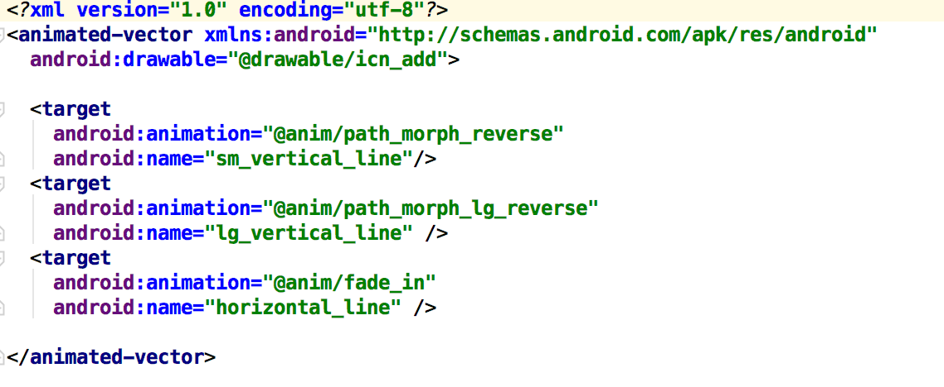
Morph FAB
Notes:
Next, you need to reverse this animation to transform the checkmark back into a plus sign.
Create another drawable resource file, this time calling it icon_morph_reverse, and replace it’s contents with the following:
The two lines that make up the final vertical line in the plus icon will now morph back into their original states and the horizontal line will fade into view, creating a smooth effect.

Slide 44
Morph FAB
Animatable mAnimatable;
mAddButton.setImageResource(R.drawable.icn_morp); mAnimatable = (Animatable) (mAddButton).getDrawable(); mAnimatable.start();
mAddButton.setImageResource(R.drawable.icn_morph_reverse); mAnimatable = (Animatable) (mAddButton).getDrawable(); mAnimatable.start();
Notes:
.Open DetailActivity.java and add the following to onClick()
Here you’re declaring a field to hold a reference to the animatable that will actually perform the animation.
Now, add the following to the bottom of the if block:
Here you set the image resource of the button to the icn_morph drawable you created earlier, extract the animatable from it, and then kick-off the animation.
Finally, add the following to the very bottom of the else branch:
Here you’re doing almost exactly the same as the previous step, except you assign icn_morph_reverse as the image resource so the animation plays out in the opposite direction.

Slide 45
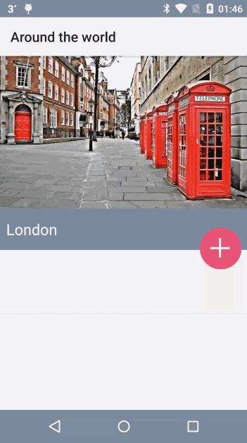
Notes:
Along with morphing the icon, the user’s click also adds the text from mEditTextTodo to the mToDoAdapterand refreshes the place activity list. This is not yet visible because of the white text, but in the next section, we’ll add vibrant color to the views so that the text stands out.
For now the FAB icon now morphs between a checkmark and a plus sign when it’s tapped.

Slide 46
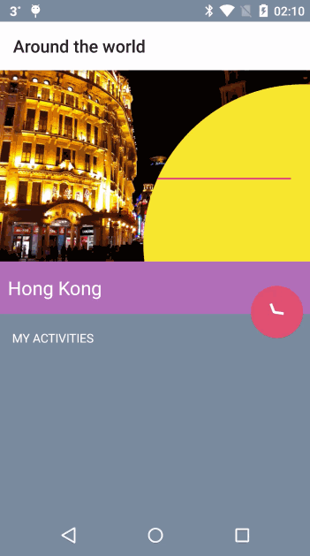
Adding Dynamic Colors to Views Using Palette API
Notes:
add colors to this view using the Palette API. dynamic colors

Slide 47
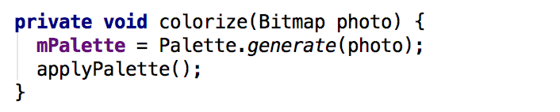
Adding Dynamic Colors to Views Using Palette API
Notes:
In DetailActivity, flesh out colorize() by adding the following:

Slide 48
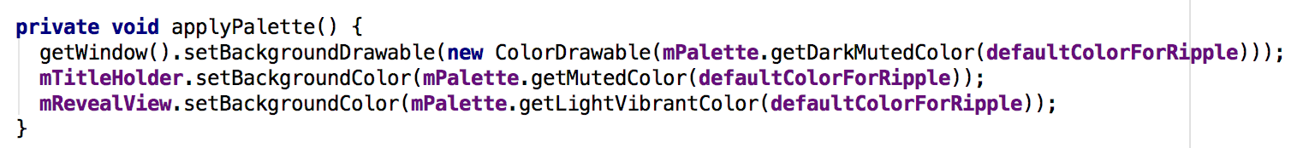
Adding Dynamic Colors to Views Using Palette API
Notes:
Just like you did previously, you generate a palette from a photo – although this time you do it synchronously – and then pass that palette onto applyPalette(). Replace the existing method stub forapplyPalette() with this code:
Here you’re you’re using the dark muted color, the muted color, and the light vibrant color as the background colors of the window, title holder, and reveal view respectively.

Slide 49
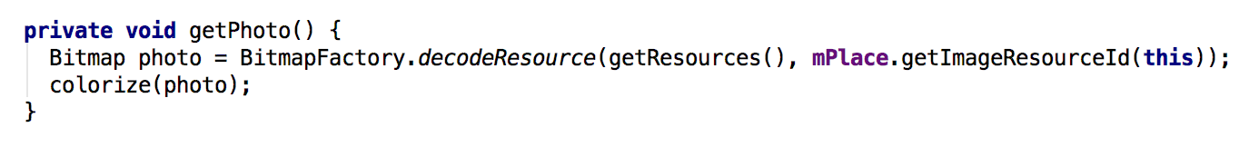
Adding Dynamic Colors to Views Using Palette API
Notes:
Finally, to kick-off this chain of events add the colorize() to the bottom of getPhoto():

Slide 50
Activity Transitions With Shared Elements
The image of the place;
The title of the place;
The background area of the title
Notes:
Activity transitions, together with shared elements, allow your app to transition between two activities that share common views. For example, you can transition a thumbnail on a list into a larger image on a detail activity, providing continuity of the content.
Between the places list view, MainActivity, and the places detail view, DetailActivity, you’re going to transition the following elements:

Slide 51
Activity Transitions With Shared Elements
<ImageView android:id="@+id/placeImage" android:layout_width="match_parent" android:layout_height="match_parent" android:scaleType="centerCrop" android:transitionName="tImage" />
Notes:
Open row_places.xml and add the following to the declaration of the ImageView tag with an id ofplaceImage:

Slide 52
Activity Transitions With Shared Elements
<LinearLayout android:id="@+id/placeNameHolder" android:layout_width="match_parent" android:layout_height="45dp" android:layout_gravity="bottom" android:orientation="horizontal" android:transitionName="tNameHolder">
Notes:
And then add this to the ImageView tag with an id of placeNameHolder:
Notice that placeName doesn’t have a transition name. This is because it is the child of placeNameHolder, which will transition all of its child views.

Slide 53
Activity Transitions With Shared Elements
<ImageView android:id="@+id/placeImage" android:layout_width="match_parent" android:layout_height="220dp" android:scaleType="centerCrop" android:transitionName="tImage" />
Notes:
In activity_detail.xml, add the following to the ImageView tag with the id placeImage:
And, in a similar fashion, add this to the ImageView tag that has an id of placeNameHolder android:transitionName="tNameHolder">
Shared elements between activities that you want to transition should have the same android:transitionName, which is what you’re setting up here. Also, notice that the size of the image, as well as the height of the placeNameHolder are much larger in this activity. You’re going to animate all of these layout changes during the activity transition to provide some nice visual continuity.

Slide 54
Activity Transitions With Shared Elements
// 1
ImageView placeImage = (ImageView) v.findViewById(R.id.placeImage); LinearLayout placeNameHolder = (LinearLayout) v.findViewById(R.id.placeNameHolder);
// 2
Pair<View, String> imagePair = Pair.create((View) placeImage, "tImage"); Pair<View, String> holderPair = Pair.create((View) placeNameHolder, "tNameHolder");
// 3
ActivityOptionsCompat options = ActivityOptionsCompat.makeSceneTransitionAnimation(MainActivity.this, imagePair, holderPair); ActivityCompat.startActivity(MainActivity.this, intent, options.toBundle());
Notes:
In onItemClickListener() found in MainActivity, add the following to the bottom of the method:
There are a couple of things to highlight here:
You get an instance of both placeImage and placeNameHolder for the given position of theRecyclerView.
You create a Pair containing the view and the transitionName for both the image and the text holder view. Note that you will once again have to manually add the import statement to the top of the file:android.support.v4.util.Pair.
To make the activity scene transition with shared views, you pass in your Pair instances and start the activity with your options bundle.

Slide 55
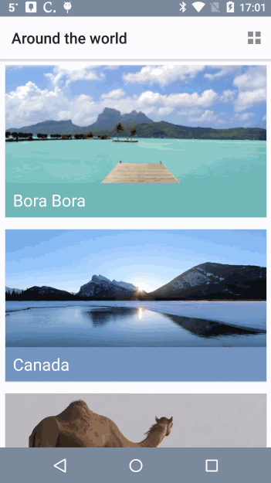
Activity Transitions With Shared Elements
Notes:
However, the animation is a bit jumpy in two areas:
The FAB button suddenly appears in DetailActivity.
If you tap on a row under the action or navigation bar, that row appears to jump a bit before it transitions.

Slide 56
Activity Transitions With Shared Elements
getWindow().getEnterTransition().addListener(new TransitionAdapter() {
@Override
public void onTransitionEnd(Transition transition) {
mAddButton.animate().alpha(1.0f);
getWindow().getEnterTransition().removeListener(this);
}
});
Notes:
You’ll solve the FAB button issue first. Open DetailActivity.java and add the following towindowTransition():
The listener you add to the enter transition is triggered when the window transition ends, which you use to fade in the FAB button.

Slide 57
Activity Transitions With Shared Elements
<ImageButton android:id="@+id/btn_add" android:layout_width="@dimen/floating_button_size" android:layout_height="@dimen/floating_button_size" android:layout_gravity="end" android:layout_marginEnd="10dp" android:layout_marginTop="28dp" android:alpha="0.0" android:background="@drawable/btn_background" android:contentDescription="@null" android:elevation="@dimen/button_elevation"/>
Notes:
For this to be effective, set the alpha to 0 for the FAB in activity_detail.xml. Find the ImageButton with a an id of btn_add and add the following to its declaration:
the FAB transition is much smoother!:

Slide 58
Action Bar
<item name="android:windowActionBar">false</item> <item name="android:windowNoTitle">true</item>
<include android:id="@+id/toolbar" layout="@layout/toolbar" />
Notes:
for the action bar and navigation bar issues, begin by adding the following to styles.xml, inside of the style tag:
Since there is no action bar defined in styles.xml, you’ll have to add it using individual XML views.
This simply includes a toolbar layout that’s provided as part of the starter project into the current layout. Now you need to make a similar change to the detail activity’s layout.
Open activity_detail.xml and add the following add the very bottom of FrameLayout, : <include android:id="@+id/toolbar" layout="@layout/toolbar_detail"/>

Slide 59
Action Bar
private Toolbar toolbar;
toolbar = (Toolbar) findViewById(R.id.toolbar); setUpActionBar();
private void setUpActionBar() { if (toolbar != null) { setActionBar(toolbar); getActionBar().setDisplayHomeAsUpEnabled(false); getActionBar().setDisplayShowTitleEnabled(true); getActionBar().setElevation(7); } }
Notes:
Next in MainActivity, you need to create an instance of, and initialize the toolbar. Add the following field to the top of the class:
Next, set the value of the field in onCreate(). Add the following to the bottom of the method:
Here you assign the result of the findViewById call to the new field, and then call setUpActionBar(). At the moment it’s just an empty method stub. Fix that now by adding the following to setUpActionBar():
Here you set the action bar to be an instance of your custom toolbar, set the visibility of the title, disable the home button, and add a subtle drop shadow by setting the elevation.

Slide 60
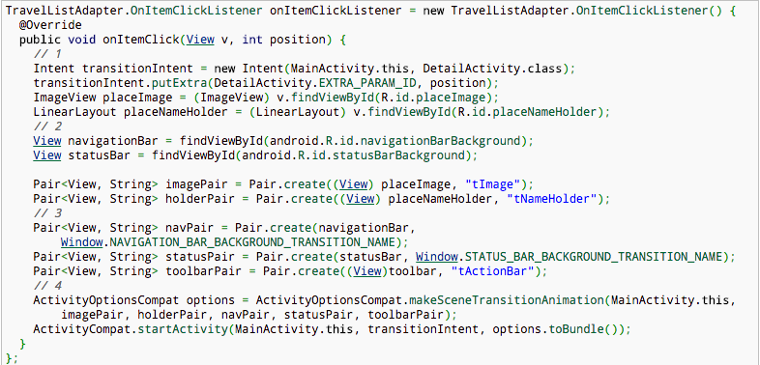
Action Bar
Notes:
Open MainActivity and replace the existing onItemClickListener with this one:
The differences between the original implementation and this one are thus:
You’ve renamed the intent to provide more context;
You get references to both the navigation bar and status bar;
You’ve created three new instances of Pair – one for the navigation bar, one for the status bar, and one for the toolbar;
And finally you’ve updated the options that passed to the new activity to include the references to the new views.

Slide 61
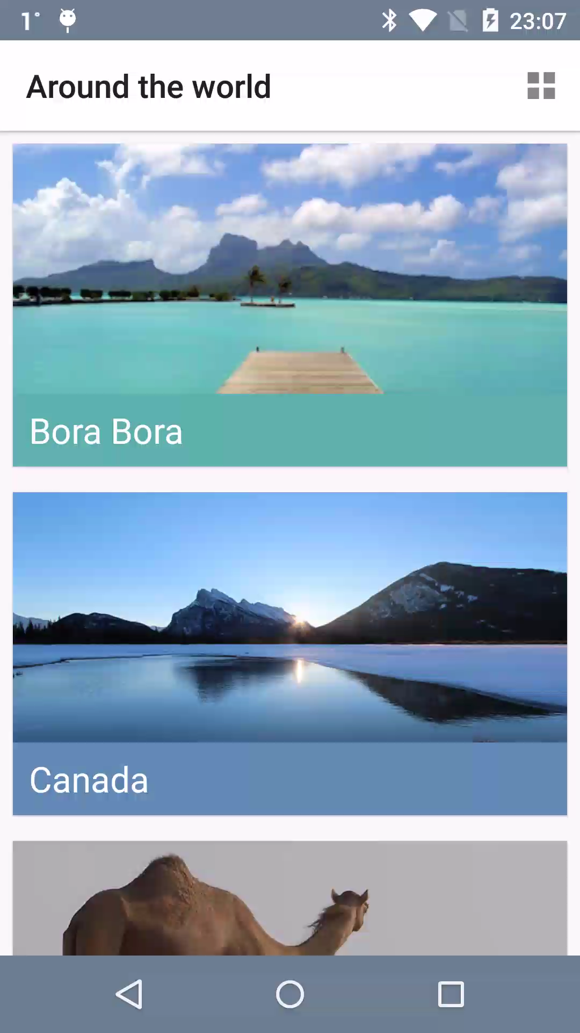
Material Design

Slide 62
Bullet Points
Implement the material theme;
Build dynamic views using new widgets like RecyclerView and CardView;
Use Palette API to generate color schemes that you can use for text or background views;
Create interactions using the animation APIs.

Slide 63
Tuesday
Design Patterns

